Slide 1

Chapter 1
Data Encoding
Dr. Kamlesh Chandravanshi
School of Computer Science & Engineering

Slide 2
Data Encoding
Encoding is the process of using various patterns of voltage or current levels to represent 1s and 0s of the digital signals on the transmission link.
The common types of line encoding are Unipolar, Polar, Bipolar, and Manchester.
Encoding Techniques
The data encoding technique is divided into the following types, depending upon the type of data conversion.

Slide 3
Analog data to Analog signals − The modulation techniques such as Amplitude Modulation, Frequency Modulation and Phase Modulation of analog signals, fall under this category.
Analog data to Digital signals − This process can be termed as digitization, which is done by Pulse Code Modulation PCM.
Digital data to Analog signals − The modulation techniques such as Amplitude Shift Keying ASK, Frequency Shift Keying FSK, Phase Shift Keying PSK, etc., fall under this category.
Digital data to Digital signals − These are in this section. There are several ways to map digital data to digital signals. Some of them are −

Slide 4
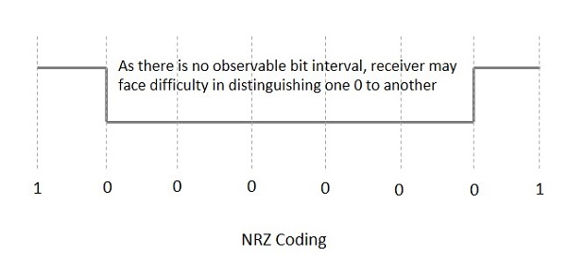
Non Return to Zero NRZ
NRZ Codes has 1 for High voltage level and 0 for Low voltage level. The main behavior of NRZ codes is that the voltage level remains constant during bit interval. The end or start of a bit will not be indicated and it will maintain the same voltage state, if the value of the previous bit and the value of the present bit are same.

Slide 5
There are two variations in NRZ namely −
NRZ - L NRZ–LEVEL
There is a change in the polarity of the signal, only when the incoming signal changes from 1 to 0 or from 0 to 1. It is the same as NRZ, however, the first bit of the input signal should have a change of polarity.
NRZ - I NRZ–INVERTED
If a 1 occurs at the incoming signal, then there occurs a transition at the beginning of the bit interval. For a 0 at the incoming signal, there is no transition at the beginning of the bit interval.

Slide 6
Bi-phase Encoding
The signal level is checked twice for every bit time, both initially and in the middle. Hence, the clock rate is double the data transfer rate and thus the modulation rate is also doubled. The clock is taken from the signal itself. The bandwidth required for this coding is greater.
There are two types of Bi-phase Encoding.
  Bi-phase Manchester
  Differential Manchester

Slide 7
Bi-phase Manchester
In this type of coding, the transition is done at the middle of the bit-interval. The transition for the resultant pulse is from High to Low in the middle of the interval, for the input bit 1. While the transition is from Low to High for the input bit 0.
Differential Manchester
In this type of coding, there always occurs a transition in the middle of the bit interval. If there occurs a transition at the beginning of the bit interval, then the input bit is 0. If no transition occurs at the beginning of the bit interval, then the input bit is 1.

Slide 8
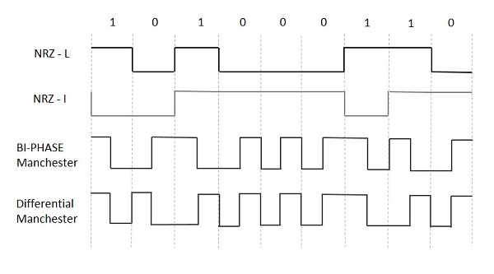
The waveforms of NRZ-L, NRZ-I, Bi-phase Manchester and Differential Manchester coding for different digital inputs.

